Slide 1

Divvy Riders: Differences Between Members and Casual Users
Erik Abdallah
Last Update: May 2021
Notes:
Analysis based on rental transactions Q2 2019 – Q1 2020

Slide 2
Objective
Identify key differences in the way Divvy Members and Casual users interact with the bike-rental service.
Find a leverage to get more memberships.

Slide 3
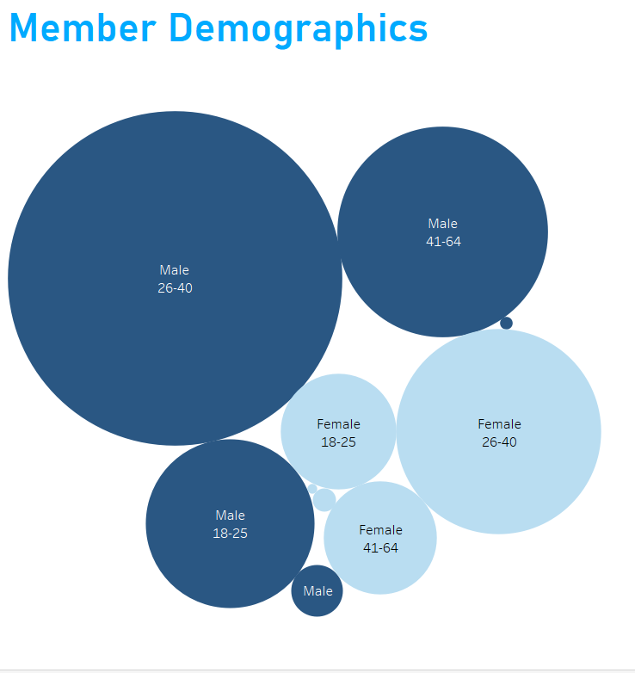
Who are our Members?
Men, late 20s and 30s: 1,033,610 Member rides
Notes:
Men in their late 20s and 30s are most attracted to the Divvy membership, with them making up 1,033,610 of RENTAL TRANSACTIONS Q2-Q4 2019. By a 500,000+ margin, we have their female counterparts and middle-aged men under them – they are secondary by a large margin.

Slide 4
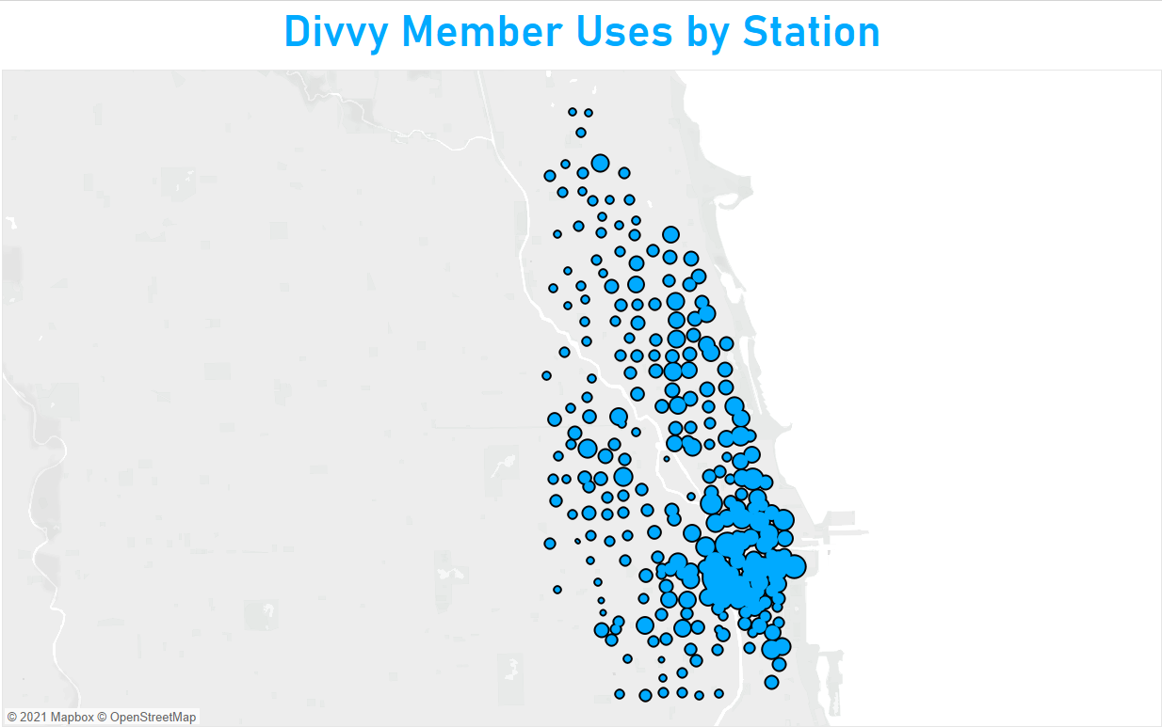
Residential areas with a mix of scenic areas
Top 3 stations: Canal St & Adams St, Clinton St & Washington Blvd, Clinton St & Madison St
Notes:
spots narrowed down to the radius with the most densely used stations
Most densely populated areas on the map are in the inner parts of the city. But many hotspots are near the Chicago River that runs through the city, which makes for a scenic walking area.

Slide 5
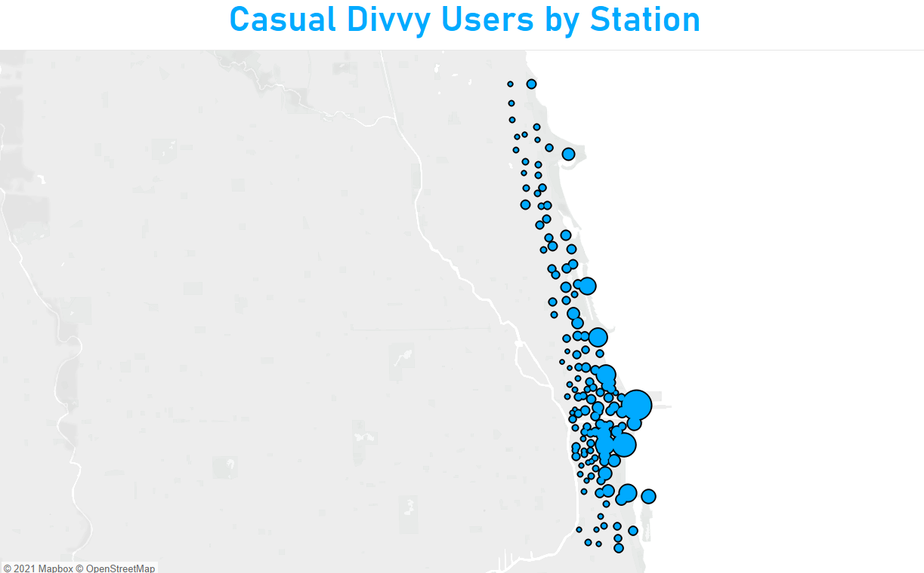
Mostly parks, tourist attractions, and areas along Lake Michigan
Top 3 Stations: Streeter Dr & Grand Ave, Lake Shore Dr & Monroe St, Millennium Park
Notes:
There is some overlap with the previous map, but it is mostly lopsided in favor of the coast, where Lake Michigan is. This is indicative of scenic strolling as well as certain city attractions. Other notable stations include Shedd Aquarium, Adler Planetarium, and Theater on the Lake.

Slide 6
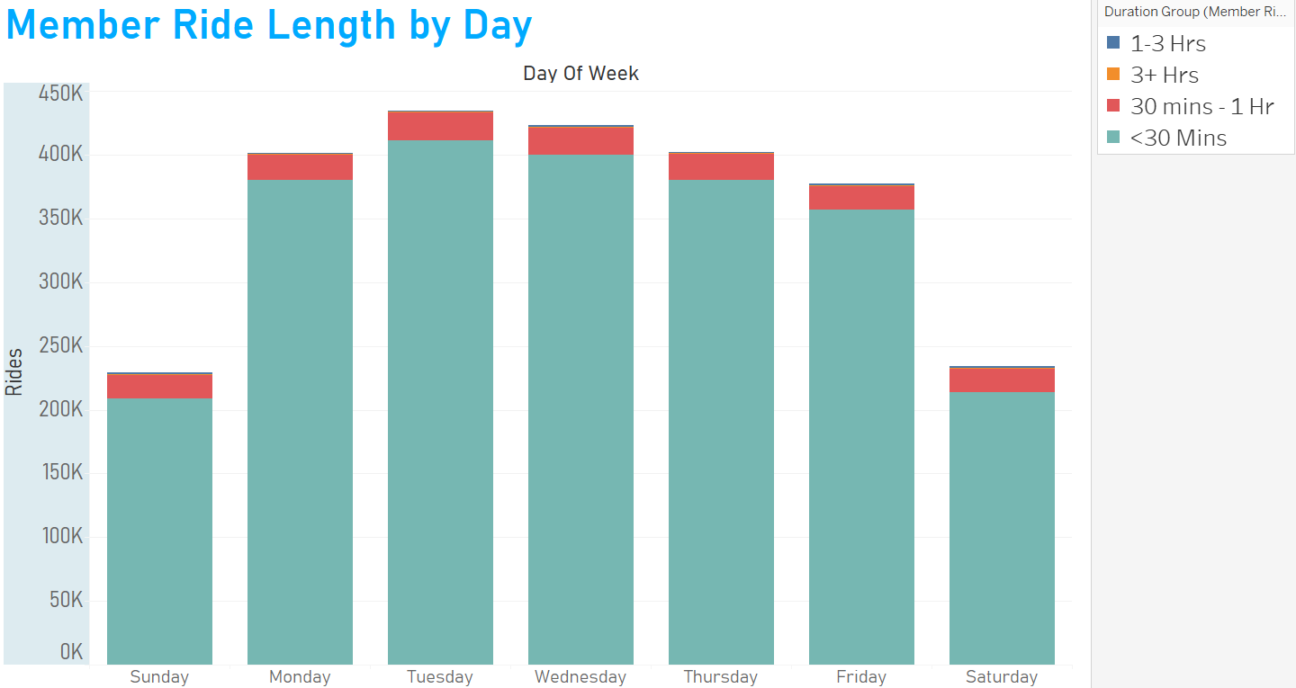
Commuters
>200,000 rentals per weekend day
Notes:
Not per day
Accumulated throughout 12-month period, partitioned by day-of-week
Weekly pattern of riders interact with the service
2X as many using it on the weekdays, but still members are using the service on the weekends

Slide 7
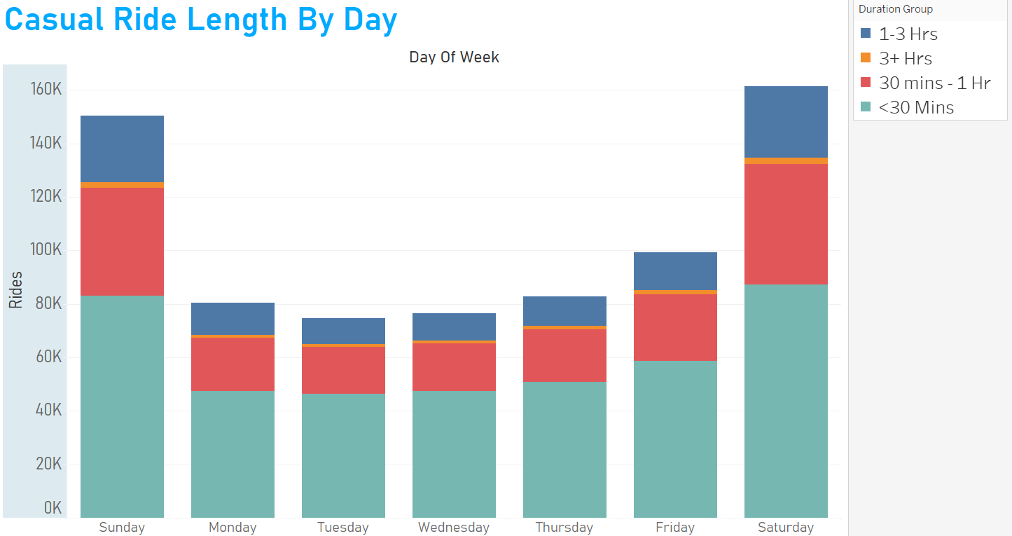
Weekdays
Strollers on weekends, but…
Notes:
This is where things get interesting. Our casual riders our riding for longer periods of time (could be either longer strolls or exercise), and highest uses are on the weekends. However, the margin between weekends and weekdays is a little smaller than for Members, and <30 mins rides still reign supreme.
I got curious about the time slots on the weekdays, when both groups of users are riding at what time. So…

Slide 8
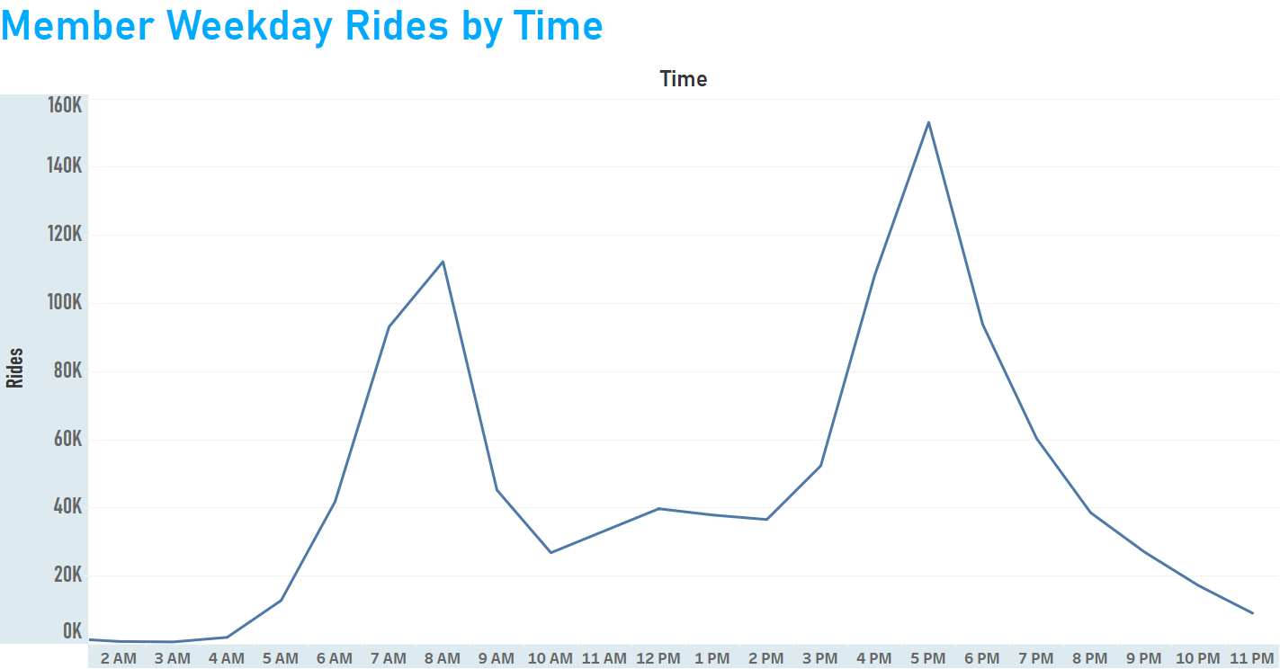
Again, commuters.
Notes:
Here’s a Monday-Friday analysis.
Just as a comparison to the more interesting chart coming up, here’s when the Members are riding throughout the hours of the day. The uptick in rides shoots straight up like a rocket at 6 AM and peaks at 8 AM and then the process repeats at 3 PM and peaks at 5 PM.

Slide 9
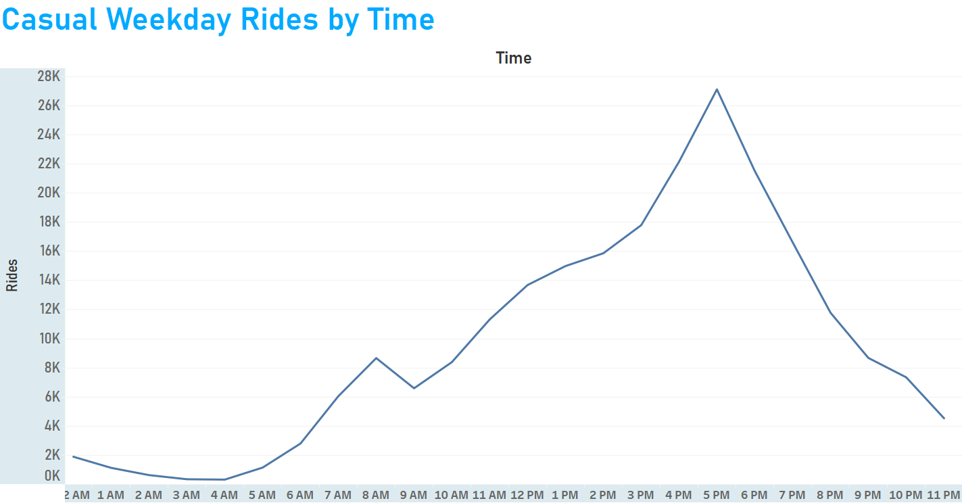
Chicago visitors?
Notes:
Look at how different this slope is.
The time uptick in rides for our Casual users throughout the day is more slow, beginning at 11 AM and peaks at 5PM. The schedule of the workday seems less relevant to this crowd because they are riding through the afternoon on all 5 weekdays.
This is the strongest indication of nonresident visitors I could find in this analysis, although they certainly are not the entire make-up of Casual riders.

Slide 10
Conclusions
1. Collect more data on casual riders to find out if they’re city visitors
2. Marketing campaign for strollers and scenic bike routes that is
Chicago-specific
Notes:
I recommend collecting more data on our Casual users and brainstorming an approachable way to survey if they are visiting the city from out-of-town (NOT asking them where they live of course; privacy is crucial). This will open a door possibilities and will garner better audience insight in the future.
Our next marketing campaign should be centered around other uses that Divvy services can have besides commuting – scenic strolls through the beautiful city of Chicago. As suggested by the Member map and bar chart, there is an overlap of those with memberships riding on weekends and near scenic areas. “Renting a bike for fun”

Slide 11
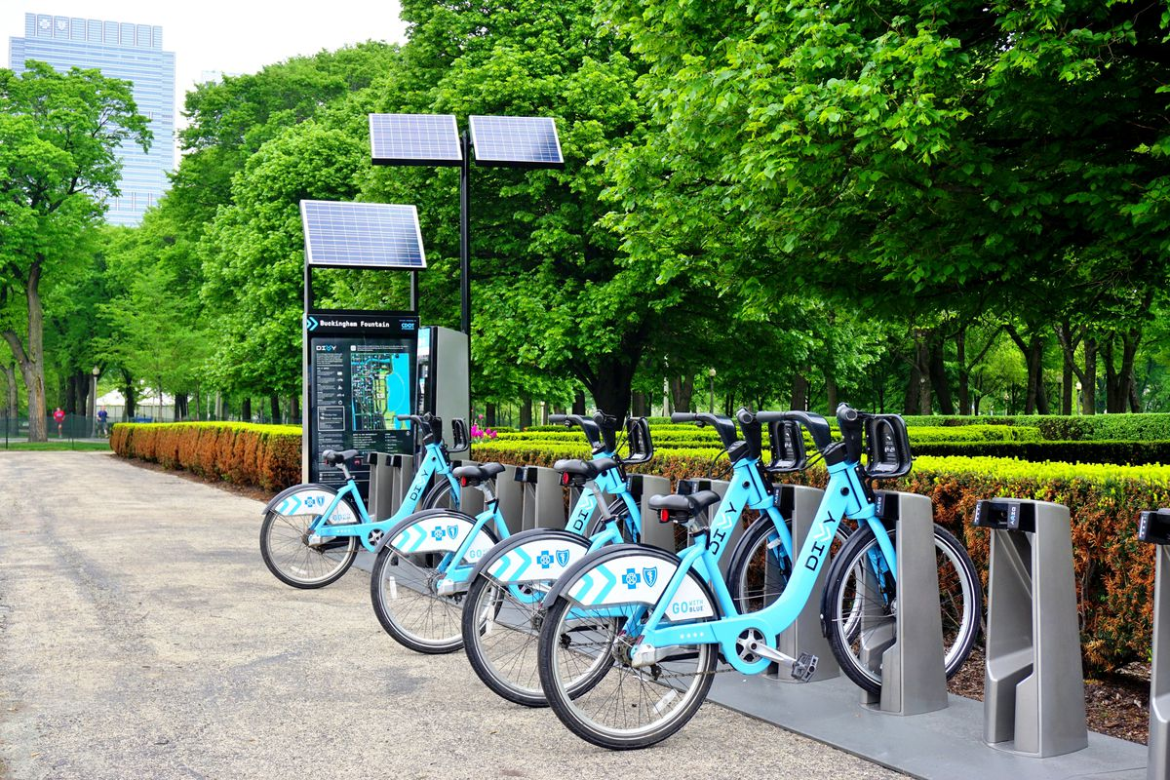
Thank you!

